Slide 1
Gold Rates

Slide 2
Why?

Slide 3
Data used
-Gold rate (1985 - Present) (https://www.kaggle.com/datasets/hemil26/gold-rates-1985-jan-2022)
-Includes two csv files (annual_gold_rate.csv, daily_gold_rate.csv)

Slide 4
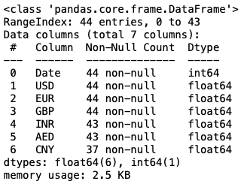
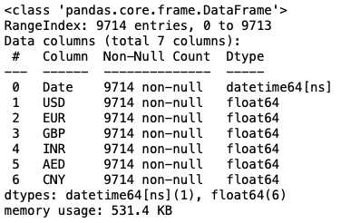
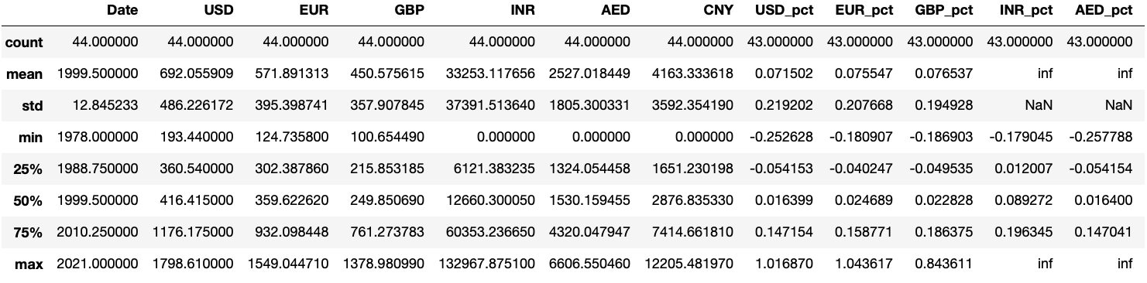

Annual Daily

Slide 5
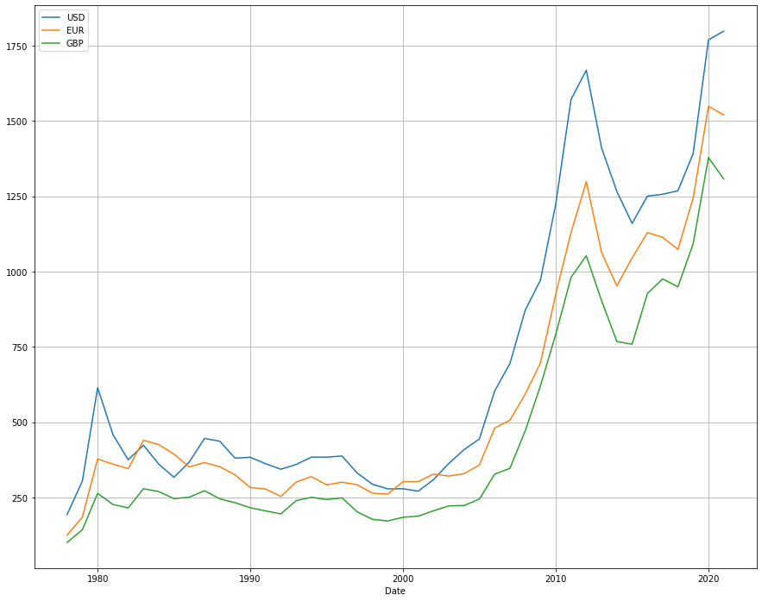
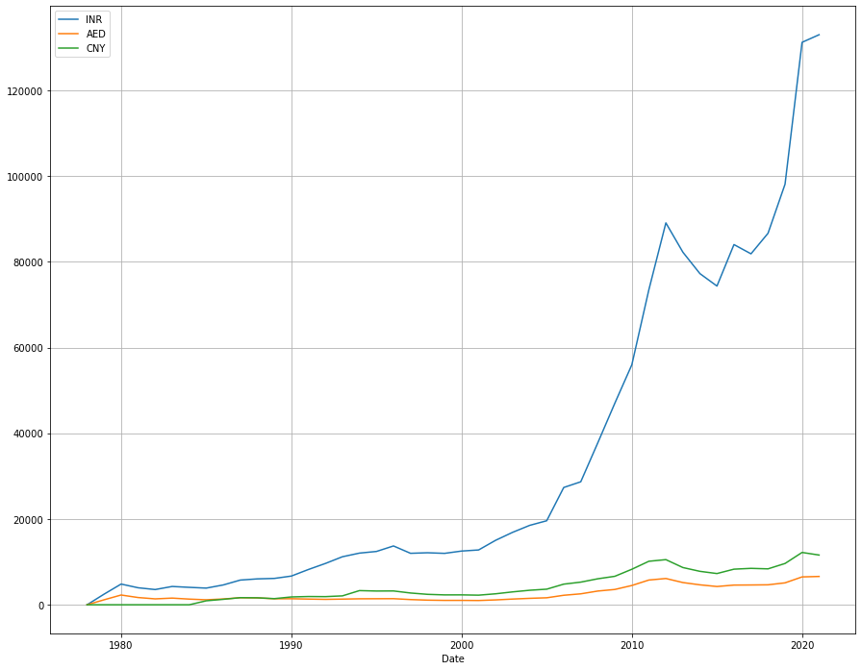
Gold price throughout the years

Slide 6
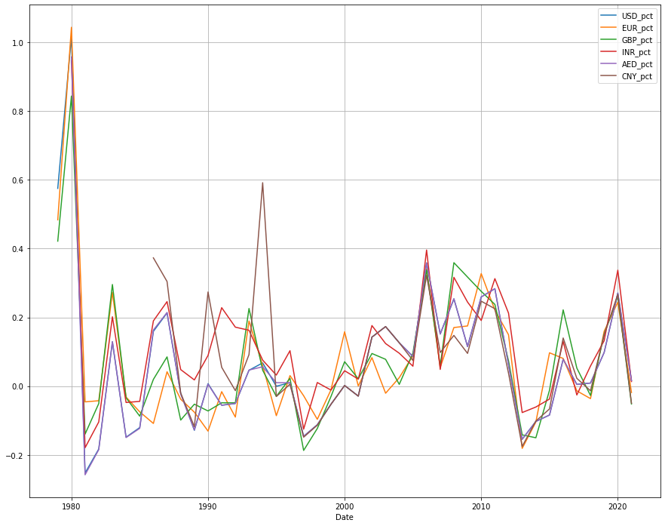
Annual percent change

Slide 7
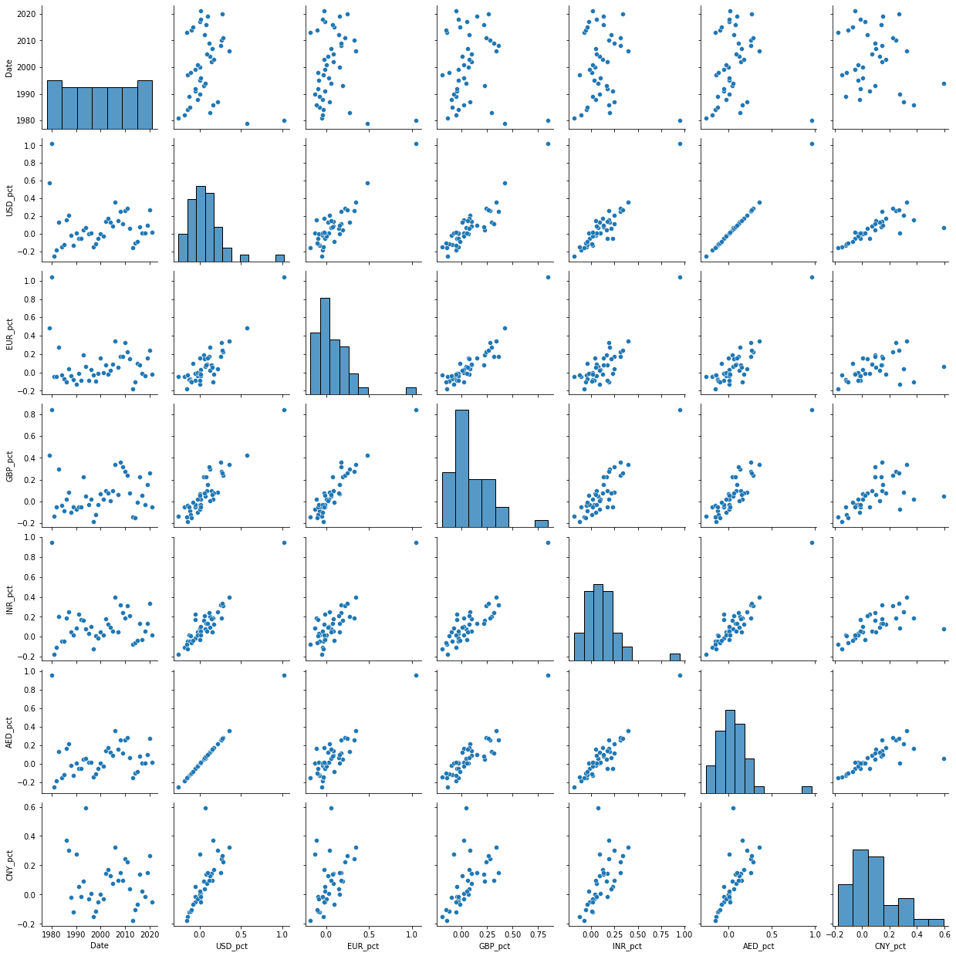
pairplot

Slide 8
Economic crisis examples
1980s = Black Monday
1990s = Early 90s recession / Black Wednesday
2000s = Late 2000s recession
2010s = European Debt Crisis
2020s = Covid / Russian Financial Crisis

Slide 9
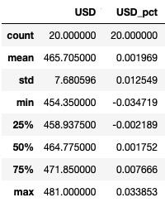
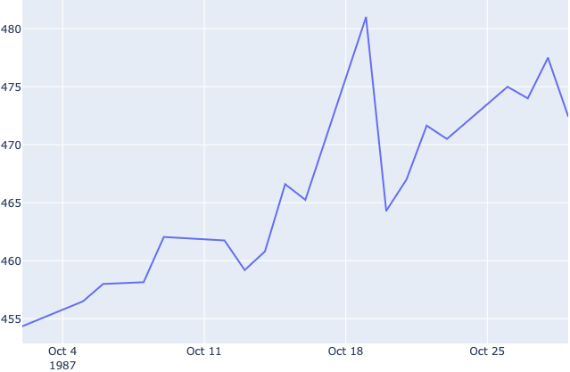
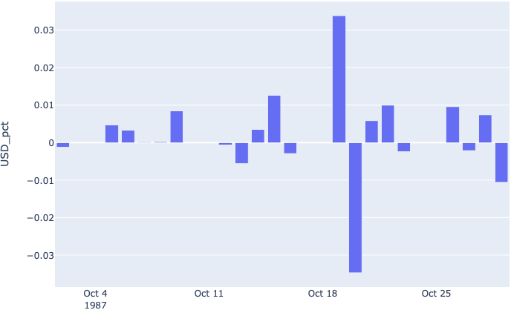
Black Monday (Oct 19th, 1987)

Slide 10
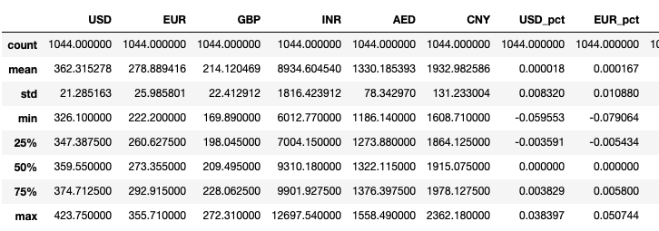
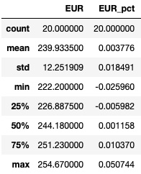
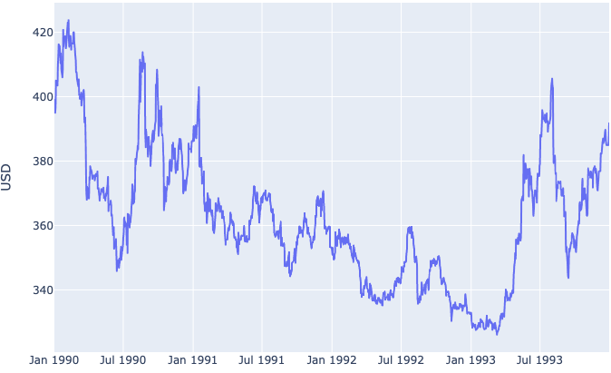
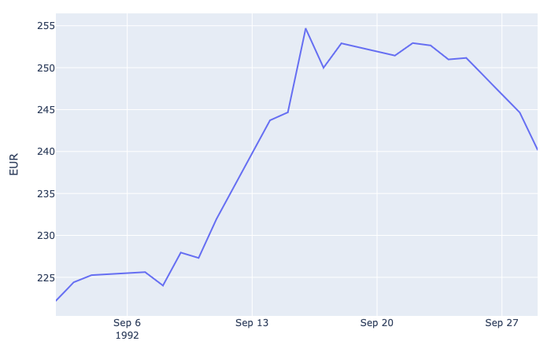
Early 90s recession
Black Wednesday

Slide 11
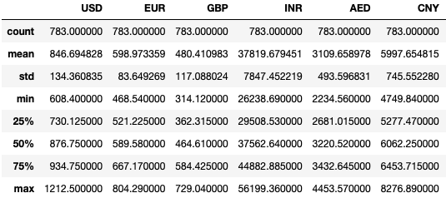
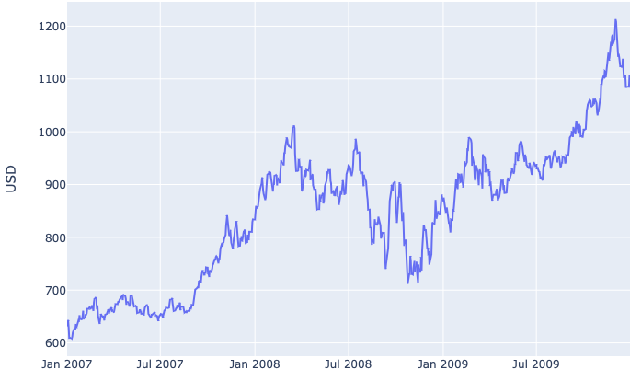
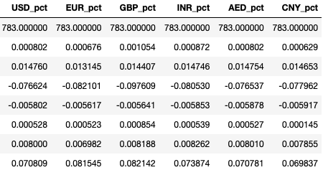
Great Recession

Slide 12
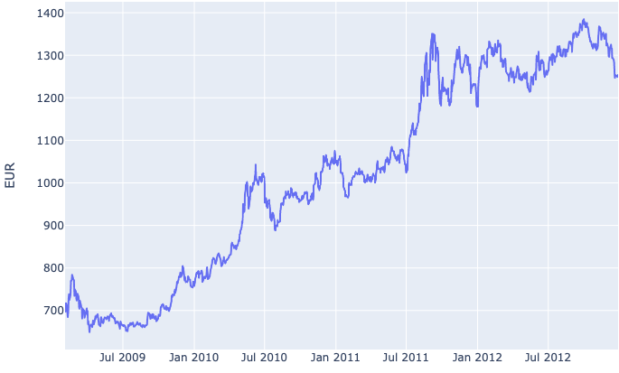
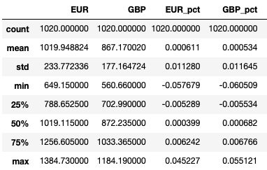
European Debt Crisis

Slide 13
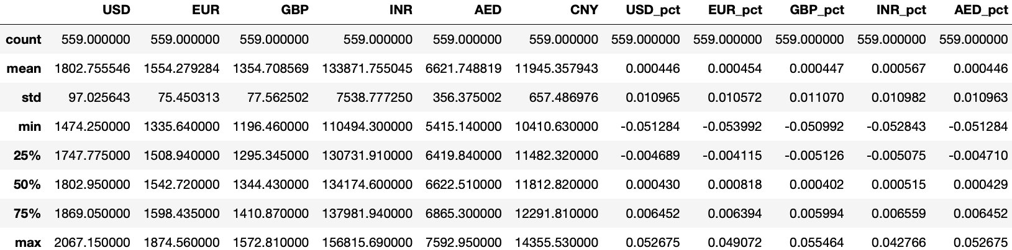
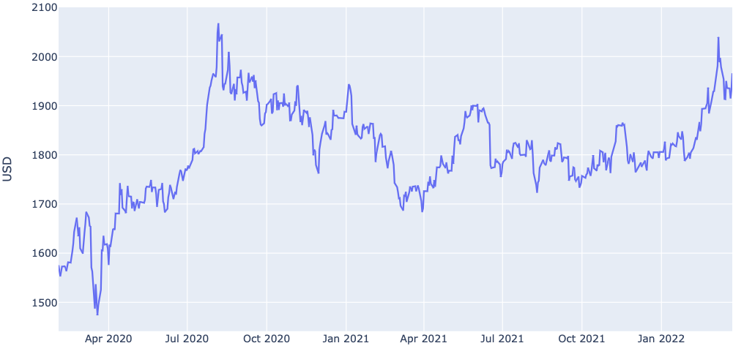
Covid
Delta
Omicron

Slide 14
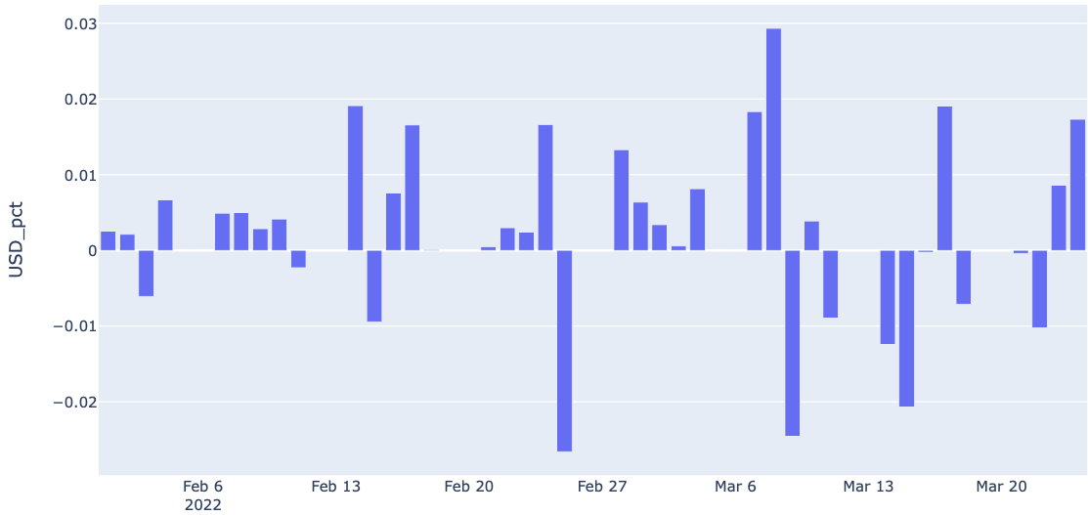
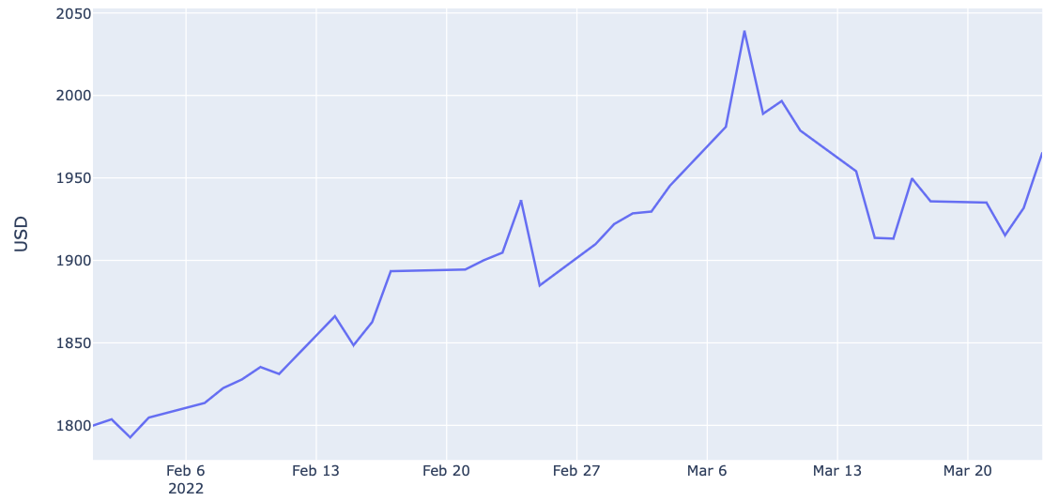
Russian Financial Crisis

Slide 15
Conclusion/Next Steps

